Slide 1


Google Analytics Report
(March 1, 2023 - March 31, 2023)
httpa://nbcypressaesthetics.com

Slide 2
SEO Performance
(Feb 1, 2023 - Feb 28, 2023)
(March 1, 2023 - March 31, 2023)
Users | 396
New Users | 384
Event count | 2.9K
Sessions | 537
Users | 436 ^ 10.1%
New Users | 418 ^ 8.9%
Event count | 3.3K ^ 12.7%
Sessions | 563 ^ 4.8%

Slide 3
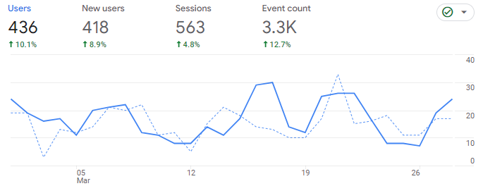
Organic Performance
(February Vs March comparison graph)
March
February

Slide 4
Traffic Acquisition
(Feb 1, 2023 - Feb 28, 2023)
(March 1, 2023 - March 31, 2023)
Sessions channel | Users 436 10.1% | Session 536 4.84% | Engaged sessions 320 26.98% | Event Count 3278 12.72%
Organic search | 188 | 263 | 193 9.04% | 1758
Direct | 149 | 174 | 49 | 787 4.65%
Organic social | 83 118.42% | 84 110% | 60 1400% | 533 289.05%
Referral | 1 | 12 140% | 6 50% | 68 223.81%
Sessions channel | Users 396 | Session 537 | Engaged sessions 252 | Event Count 2908
Organic search | 189 | 274 | 177 | 1896
Direct | 154 | 195 | 59 | 752
Organic social | 38 | 40 | 4 | 137
Referral | 4 | 5 | 4 | 21

Slide 5
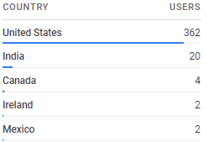
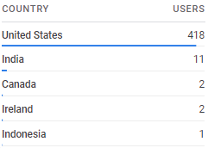
Demographics (Country)
Users
(Feb 1, 2023 - Feb 28, 2023)
(March 1, 2023 - March 31, 2023)

Slide 6
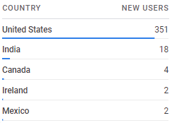
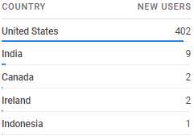
Demographics (Country)
New Users
(Feb 1, 2023 - Feb 28, 2023)
(March 1, 2023 - March 31, 2023)

Slide 7
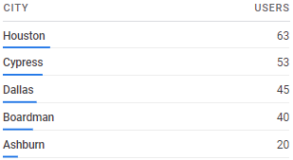
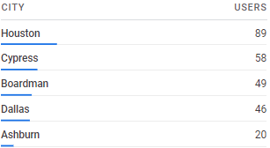
Demographics (City)
Users
(Feb 1, 2023 - Feb 28, 2023)
(March 1, 2023 - March 31, 2023)

Slide 8
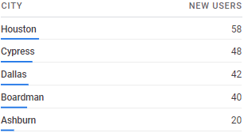
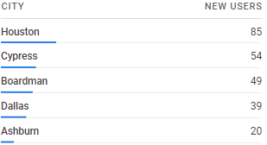
Demographics (City)
New Users
(Feb 1, 2023 - Feb 28, 2023)
(March 1, 2023 - March 31, 2023)

Slide 9
Thank You

